Slide 1
CS 4476 PS2
Peter gray
pgray31@gatech.edu
pgray31
903393428

Slide 2
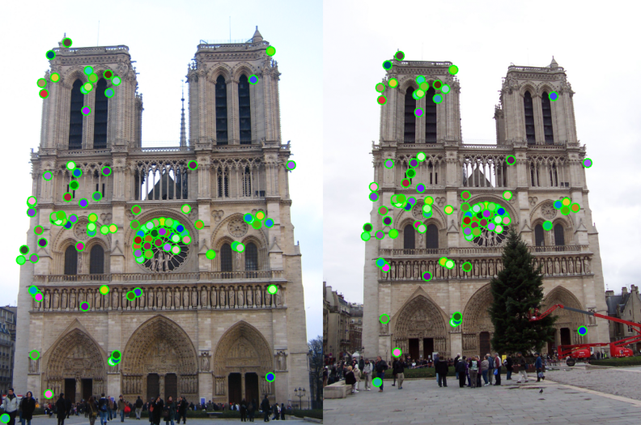
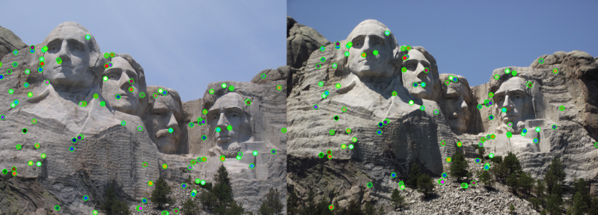
1.1: Harris Corner Detector
<insert visualization of Notre Dame interest points from ps2.ipynb here> [2.5 pts]
< insert visualization of Rushmore interest points from ps2.ipynb here > [2.5 pts]

Slide 3
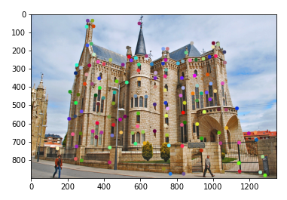
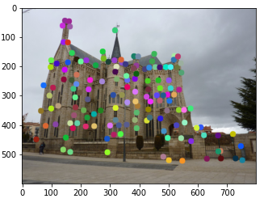
1.1: Harris Corner Detector
< insert visualization of Gaudi interest points from ps2.ipynb here > [2.5 pts]

Slide 4
1.1: Harris Corner Detector
Briefly describe how the Harris corner detector works. [1 pt]
The corner detection works by taking looking at the slope and curvature of an image about all directions. (first and second derivative), it looks at the rate of change of the color and if it is above a certain threshold, it is classified as a corner.
What does the second_moments() helper function do? [1 pt]
creates a gradient matrix upon which the corner response method can detect the appropriate changes for a valid corner .
What does the corner_response() helper function do? [1 pt]
Gives each pixel a corner response value, the higher the response, the greater the change in gradients, the more of a “corner” that pixel is

Slide 5
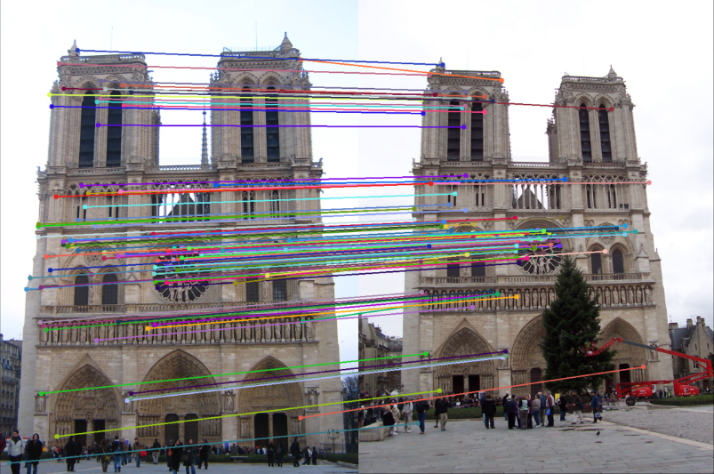
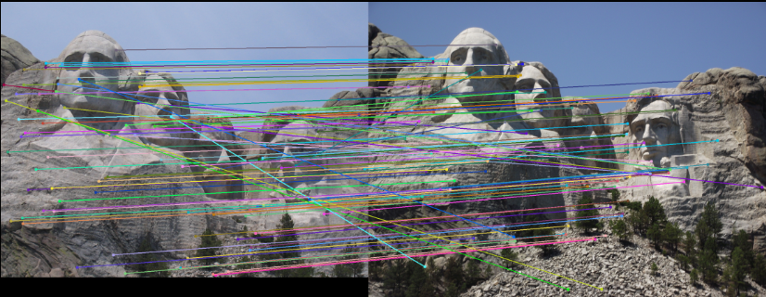
1.3: Feature Matching
<insert feature matching visualization of Notre Dame from ps2.ipynb> [2.5 pts]
<insert feature matching visualization of Rushmore from ps2.ipynb > [2.5 pts]

Slide 6
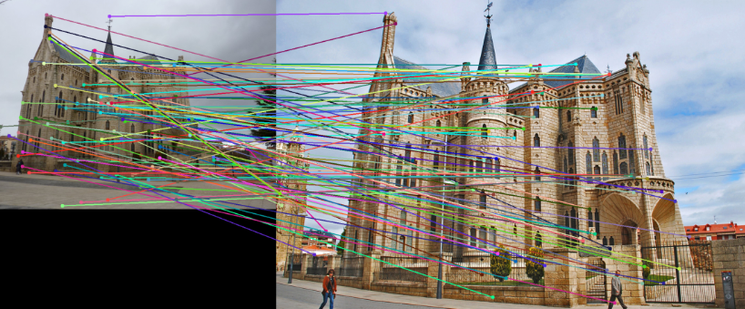
1.3: Feature Matching
<insert feature matching visualization of Gaudi from ps2.ipynb > [2.5 pts]
<Describe your implementation of feature matching.> [1.5 pts]
Find the distances between each pair of features. For each feature in one set, find the two features in the other set with the lowest distance. The lowest will be the matched feature. The ratio between the lowest and the second lowest will be the confidence associated with that match. Then, sort the match set based on confidence and return the most confident matches.

Slide 7
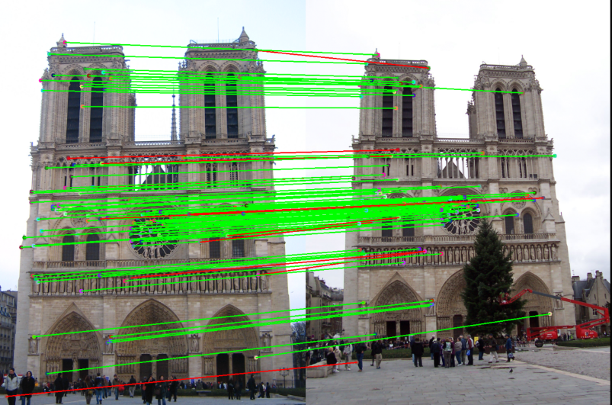
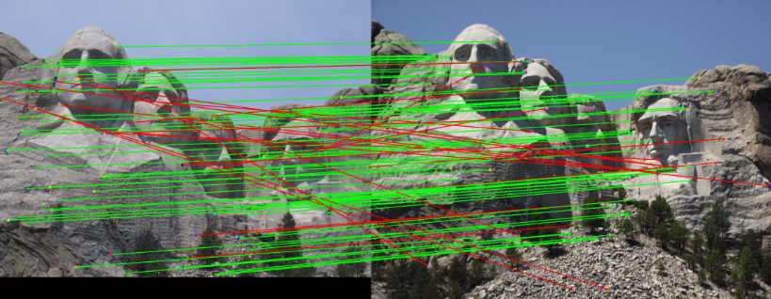
Results: Ground Truth Comparison
<Insert visualization of ground truth comparison with Notre Dame from ps2.ipynb here> [1 pt]
<Insert visualization of ground truth comparison with Rushmore from ps2.ipynb here> [1 pt]

Slide 8
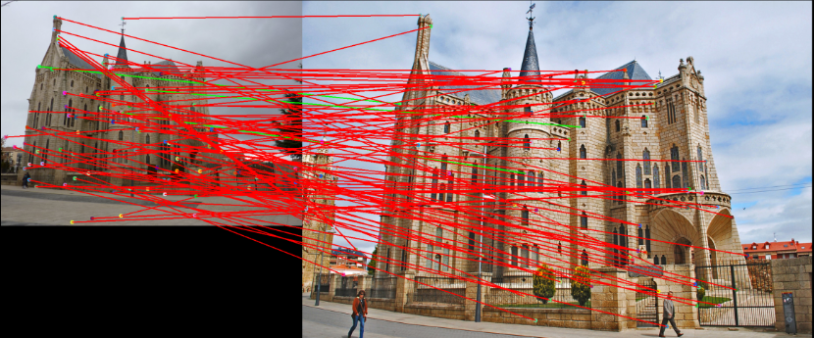
Results: Ground Truth Comparison
<Insert visualization of ground truth comparison with Gaudi from ps2.ipynb here> [1 pt]
<Insert numerical performances on each image pair here. Also discuss what happens when you change the 4x4 subgrid to 2x2, 5x5, 7x7, 15x15 etc?> [2.5 pts]
Notre dame accuracy : 89%
Rushmore accuracy : 77%
Gaudi accuracy: 3%

Slide 9
1.4(a): Hyperparameter Tuning part 1 [Extra credit]
<Insert images of the ground truth correspondence and their corresponding accuracies for varying sigma in the second moments [3, 6, 10, 30] > [0.5 pts]
When changing the values for large sigma (>20), why are the accuracies generally the same? [0.5 pts]

Slide 10
1.4(a): Hyperparameter Tuning part 2 [Extra credit]
<Insert images of the ground truth correspondence and their corresponding accuracies for varying feature width in the SIFT [8, 16, 24, 32] > [0.5 pts]
What is the significance of changing the feature width in SIFT? [0.5 pts]

Slide 11
1.4(c): Accelerated Matching [Extra credit]
<Insert Runtime/Accuracy of your faster matching implementation. What did you try and why is it faster?> [1 pts]

